Slide 1
HTML

Slide 2
HTML Introduction
HTML is an essential building block of any webpage. It describes the structure and semantics (meaning) of content rather than its appearance.
HTML stands for Hypertext Markup Language. It’s made up of a set of markup tags and symbols which tell browsers how to display images and words on a web page.
The term 'Hypertext Markup Language' is composed of two main words: 'hypertext' and 'markup language.' 'Hypertext' refers to the linking of text with other documents, while 'markup language' denotes a language that utilizes a specific set of tags.
HTML tags are written in angle brackets (< and >) and tell what kind of information goes inside them, such as headings, paragraphs or lists etc.

Slide 3
How do HTML, CSS, and JavaScript work together?
In building a webpage, think of HTML, CSS, and JavaScript as different parts of a car. HTML is like the car's skeleton, forming the basic structure and frame.
CSS adds the paint and finishing touches, making the car look appealing with color, style, and design.
JavaScript is similar to the engine and mechanical parts, infusing the car with functionality, movement, and interactive features.
Similarly, when developing a website, HTML lays out the structure, CSS enhances its visual appeal, and JavaScript provides interactivity and dynamic content.

Slide 4




Slide 5
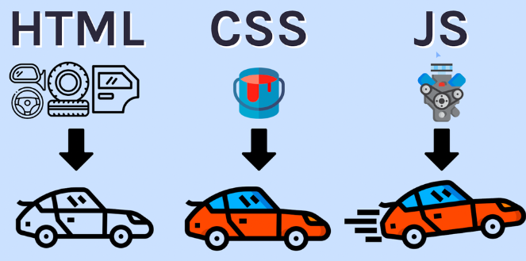

Slide 6
How do websites work?
When we want to access any information on the internet, we search for it using a web browser. The web browser retrieves the content from web servers, where it is stored in the form of HTML documents.
An HTML document is created by writing code with specific tags in a code. The document is then saved with the '.html' extension. Once saved, the browser interprets the HTML document, reads it, and renders the web page.

Slide 7
What is a Web Browser?
A web browser is a program that understands HTML tags and renders them in a human-readable format that is easily viewable by people visiting the website. Developers write code in HTML because it's a straightforward way to instruct the web browser on what to display.
What is an HTML Document?
An HTML document is a text document saved with the '.html' or '.htm' extension, containing text and specific tags enclosed in '< >'. These tags provide the necessary instructions for configuring the web page.
What is a Rendered Page:
The rendered page is the output screen of our HTML Document which is the page displayed on the browser.

